Slide 1
Chapter 7: Query Processing and Optimization

Slide 2
Query Processing
The query processor turns user queries and data modification commands into a query plan - a sequence of operations (or algorithm) on the database
  from high level queries to low level commands
Decisions taken by the query processor
  Which of the algebraically equivalent forms of a query will lead to the most efficient algorithm?
  For each algebraic operator what algorithm should we use to run the operator?
  How should the operators pass data from one to the other? (eg, main memory buffers, disk buffers)

Slide 3
Issues in Query Processing and Optimization
Generate Plans
  employ efficient execution primitives for computing relational algebra operations
  systematically transform expressions to achieve more efficient combinations of operators
Estimate Cost of Generated Plans
  Statistics
“Smart” Search of the Space of Possible Plans
  always do the “good” transformations (relational algebra optimization)
  prune the space (e.g., System R)
Often the above steps are mixed

Slide 4


Basic Steps in Query Processing
Query processing and Optimization
1. Parsing and translation
2. Optimization
3. Evaluation

Slide 5
Basic Steps in Query Processing (Cont.)
Parsing and translation
  translate the query into its internal form. This is then translated into relational algebra.
  Parser checks syntax, verifies relations
Evaluation
  The query-execution engine takes a query-evaluation plan, executes that plan, and returns the answers to the query.

Slide 6
Relational Query Optimization
SQL
select
statement
declarative
language
parser
inefficient
relational
algebra
expression
efficient
relational
algebra
expression
optimizer
generative
programming
code
generator
automatic
programming
efficient
program

Slide 7
Basic Steps in Query Processing : Optimization
A relational algebra expression may have many equivalent expressions
  E.g., σ_{balance<2500}(∏_{balance}(account)) is equivalent to
  ∏_{balance}(σ_{balance<2500}(account))
Each relational algebra operation can be evaluated using one of several different algorithms
  Correspondingly, a relational-algebra expression can be evaluated in many ways.
Annotated expression specifying detailed evaluation strategy is called an evaluation-plan.
  E.g., can use an index on balance to find accounts with balance < 2500,
  or can perform complete relation scan and discard accounts with balance ≥ 2500

Slide 8
Basic Steps: Optimization (Cont.)
Query Optimization: Amongst all equivalent evaluation plans choose the one with lowest cost.
  Cost is estimated using statistical information from the
  database catalog
    e.g. number of tuples in each relation, size of tuples, etc.
In this chapter we study
  How to measure query costs
  Algorithms for evaluating relational algebra operations
  How to combine algorithms for individual operations in order to evaluate a complete expression
In Chapter 14
  We study how to optimize queries, that is, how to find an evaluation plan with lowest estimated cost

Slide 9
Measures of Query Cost
Cost is generally measured as total elapsed time for answering query
  Many factors contribute to time cost
    disk accesses, CPU, or even network communication
Typically disk access is the predominant cost, and is also relatively easy to estimate. Measured by taking into account
  Number of seeks * average-seek-cost
  Number of blocks read * average-block-read-cost
  Number of blocks written * average-block-write-cost
    Cost to write a block is greater than cost to read a block
      data is read back after being written to ensure that the write was successful

Slide 10
Measures of Query Cost (Cont.)
For simplicity we just use number of block transfers from disk as the cost measure
  We ignore the difference in cost between sequential and random I/O for simplicity
  We also ignore CPU costs for simplicity
Costs depends on the size of the buffer in main memory
  Having more memory reduces need for disk access
  Amount of real memory available to buffer depends on other concurrent OS processes, and hard to determine ahead of actual execution
  We often use worst case estimates, assuming only the minimum amount of memory needed for the operation is available
Real systems take CPU cost into account, differentiate between sequential and random I/O, and take buffer size into account
We do not include cost to writing output to disk in our cost
formulae

Slide 11
Join Operation
Several different algorithms to implement joins
  Nested-loop join
  Block nested-loop join
  Indexed nested-loop join
  Merge-join
  Hash-join
Choice based on cost estimate
Examples use the following information
  Number of records of customer: 10,000 depositor: 5000
  Number of blocks of customer: 400 depositor: 100

Slide 12
Query Optimization
Alternative ways of evaluating a given query
  Equivalent expressions
  Different algorithms for each operation (Chapter 13)
Cost difference between a good and a bad way of evaluating a query can be enormous
  Example: performing a r X s followed by a selection r.A = s.B is much slower than performing a join on the same condition
Need to estimate the cost of operations
  Depends critically on statistical information about relations which the database must maintain
    E.g. number of tuples, number of distinct values for join attributes, etc.
  Need to estimate statistics for intermediate results to compute cost of complex expressions
Relations generated by two equivalent expressions have the same set of attributes and contain the same set of tuples, although their attributes may be ordered differently.

Slide 13
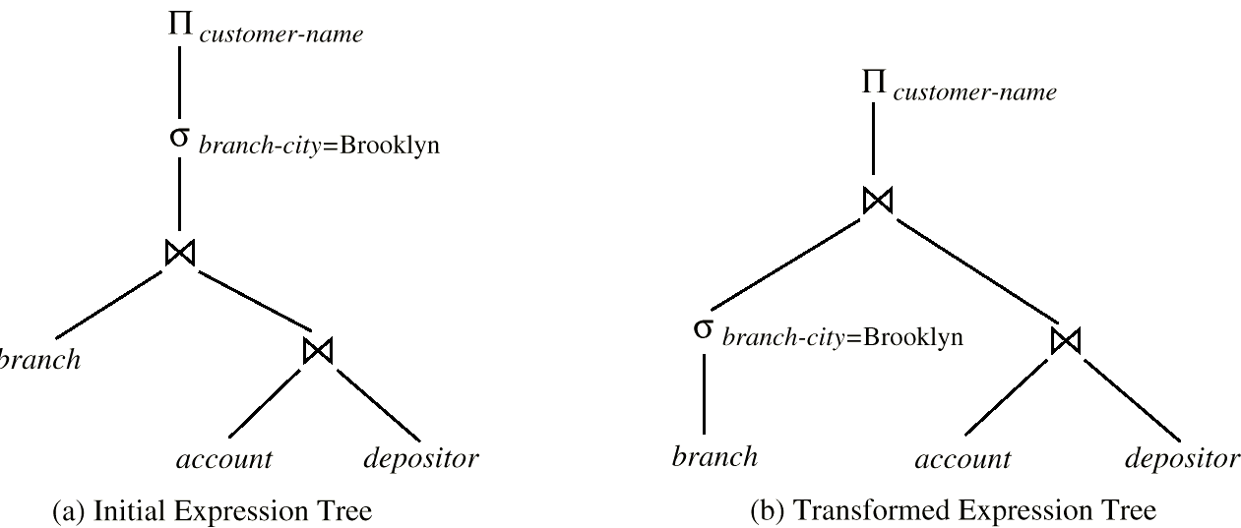
Generation of query-evaluation plans for an expression involves several steps:
  Generating logically equivalent expressions
    Use equivalence rules to transform an expression into an equivalent one.
  Annotating resultant expressions to get alternative query plans
  Choosing the cheapest plan based on estimated cost
The overall process is called cost based optimization.

